Slide 1
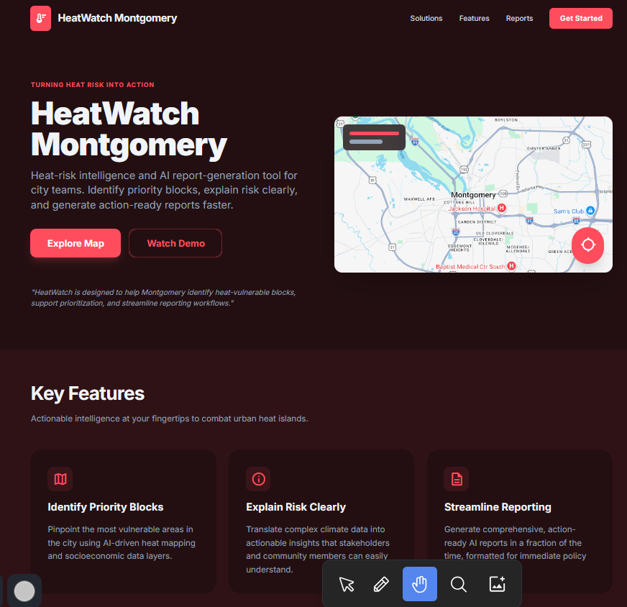



HeatWatch Montgomery
Title page: What are we about
Title Page
Picture of HEATWATCH PRODUCT
Heat-risk intelligence and AI report-generation tool for city teams.
Identify priority districts
Explain risk clearly
Generate action-ready report.
Presented to you by Team GRANT US SHADE
Send me pictures you want a specific headshot

Slide 2
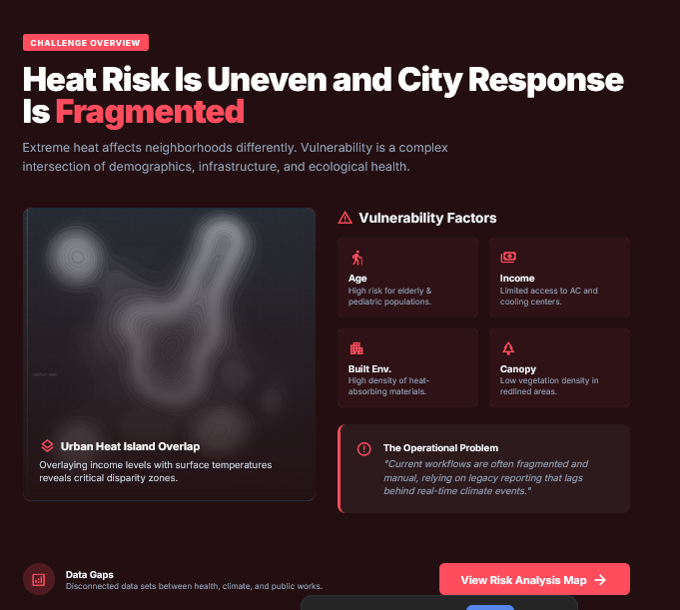




Heat Risk is uneven, city response is fragmented.
Challenge Statement: Heat Risk is uneven, city response is fragmented. Fundings are provided but it takes manual effort from limited city resources
Challenge Statement
Fundings are provided but it takes manual effort from limited city resources. Poorer districts have lesser resources for administrative proceedings such as grant application report filings.
City suffers from heat related problems
City has funding options but require hard evidence
Richer districts applies for funding and evidence backing
Funding gets approved for improvement programs
Vulnerability and safety for the ELDERLY LOWER INCOME
INFRASTRUCTURE
GREEN CANOPY
Poor districts prioritizes more pressing issues than application of grant
With HEATWATCH, cities spend 10% of total resource and still apply for funds
Social Impact, City Efficiency, & Funding Readiness
Converting raw data into high-fidelity, funding-ready documentation to accelerate urban development and community support.
People Visibility for vulnerable residents through hyper-local data mapping and social vulnerability index integration.
City Operations Faster prioritization for municipal needs with automated workflows and cross-departmental data synchronization.
Economics AI-assisted reporting reduces manual effort, allowing staff to focus on strategy rather than documentation.

Slide 3
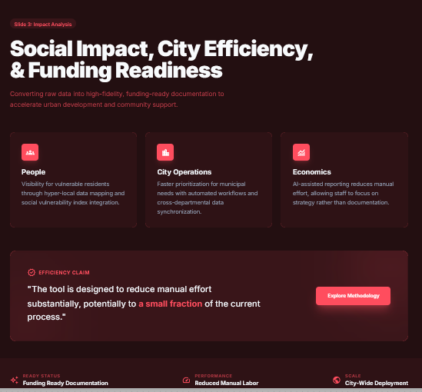
Individual, city, economics
Why this matters: Persona page – telling the story of benefits from different pov
Why this matters
Target audience:
Grant application municiple staff challenges: xxxx
Benefits: xxx
Secondary product benefitor:
ELDERY PRONE TO HEAT STROKE
We have the right expertise in this topics
Our profiles here
Secondary product benefitor:
Business owner for small construction company
Secondary product benefitor:
Home owner, less energy consumption

Slide 4
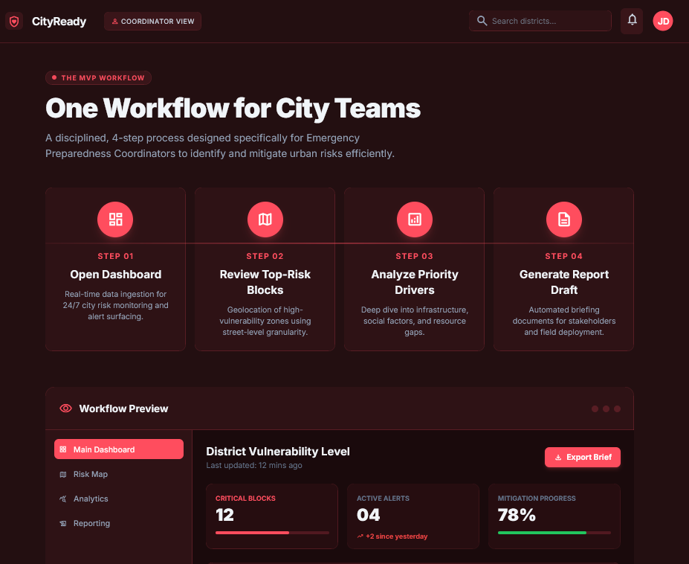
To be adapted to storyline

Slide 5
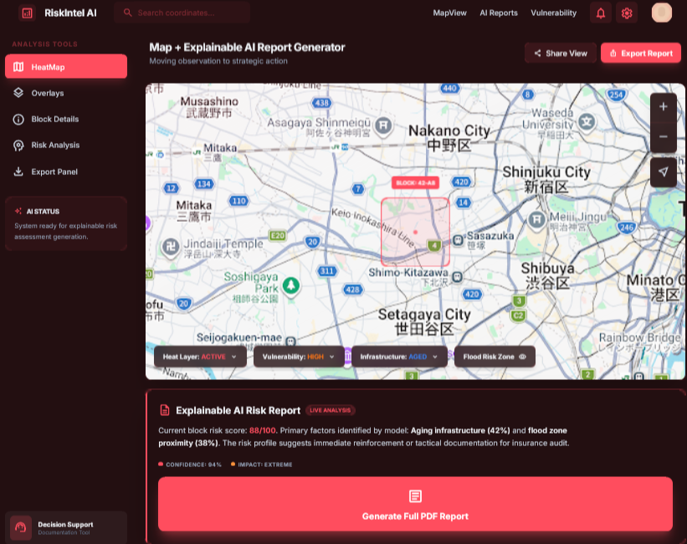
To be adapted to storyline

Slide 6
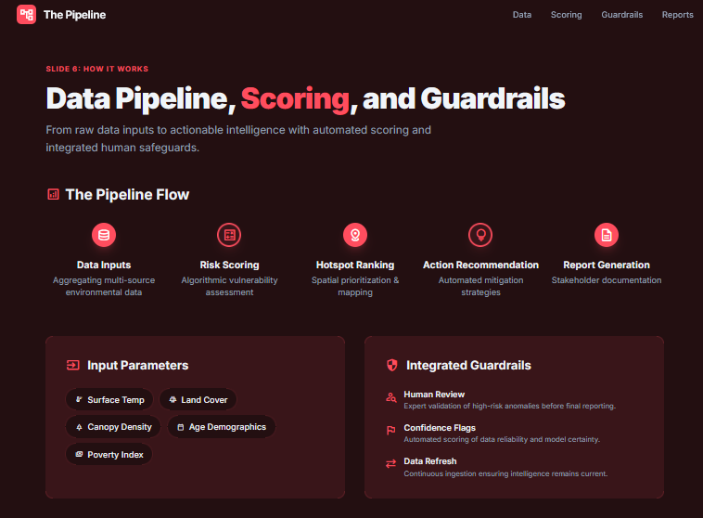
To be adapted to storyline

Slide 7
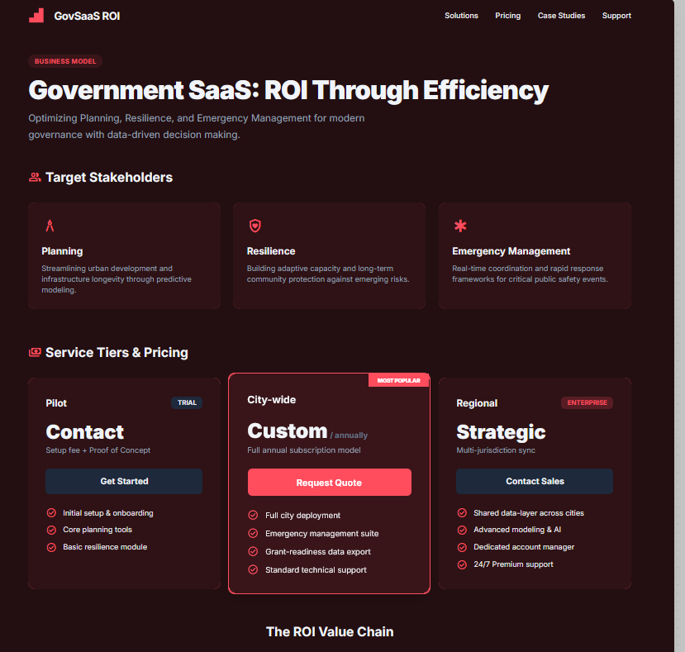
To be adapted to storyline

Slide 8
Nest steps – how to develop this product to full potential

